Slide 1
Wi-Fi automation lab Lab Guide - Day 1
Andreas Koksrud / Telenor Bedrift
Co-authors:
Kjetil Teigen Hansen & François Vergès

Slide 2
References / inspiration
References
https://github.com/CiscoDevNet/yangsuite/
https://postman.com
https://docs.ansible.com/ansible/latest/collections/cisco/ios/ios_facts_module.html
https://www.wifireference.com/2020/01/14/viewing-network-telemetry-from-the-catalyst-9800-with-grafana/
https://grafana.com/grafana/dashboards/13462-device-health-monitoring/
https://grafana.com/grafana/dashboards/12468-catalyst-9800-client-stats/
https://wirelessisfun.wordpress.com/2020/12/10/network-telemetry-data-and-grafana-part-1-the-advanced-netconf-explorer/
https://python.org
https://codeium.com

Slide 3
Copyright
Copyright
© Andreas Koksrud 2025. All rights reserved. This presentation is provided for educational and informational purposes only. You may distribute and learn from this presentation, but commercial use or any form of monetization is strictly prohibited without prior written consent
Any slides marked Kjetil Teigen Hansen or the Conscia logo will also have full or co-ownership by Kjetil
Any slides marked François Vergès or the SemFio logo will also have full or co-ownership by François

Slide 4
Prerequisites
Prerequisites
Cisco Meraki account (https://dashboard.meraki.com)
Juniper MIST account (https://manage.mist.com)
Postman account (https://postman.com)
Complete the pre-lab exercises before the deep dive labs
Bring an Ethernet dongle if you don't have built-in port
(optional) Bring an extra screen to show lab guide (or prepare to Alt-Tab)

Slide 5

Communications
Communications
WebEx space: Wi-Fi automation lab
Please help each other
Sharing is caring ☺

Slide 6
Agenda
Agenda
Pre-lab
Choose your hypervisor
Install Ubuntu Server w/Docker
Install Postman
Install VS Code
Day 1
Day 2
In-depth explore a topic of choice
Sort out pre-lab task problems
Grafana / TIG-stack
Grafana Cloud
Ansible
Python
Cloud vendor automation (MIST or Meraki)
Get to know the lab environment
Connect VS Code to Ubuntu
Install and explore Ansible
Explore Python automation
Install and explore YANG Suite
Explore Postman
Install and explore Grafana
(optional) install 9800-CL

Slide 7
Scope
Scope
In scope
Getting started with various systems/languages/solutions for lab purposes
Set up your own Ubuntu Linux server on your own laptop. It will be possible to use a shared server if you do not want or have possibility to install an Ubuntu VM on your laptop
Some nice examples to try various aspects of automation
Inspiring you to explore deeper on your own
Out of scope topics
Git
Learning the languages (Ansible, Python, InfluxQL, etc)
Learning Linux
Deploying the systems for production use
Troubleshooting WLC/AP connection

Slide 8
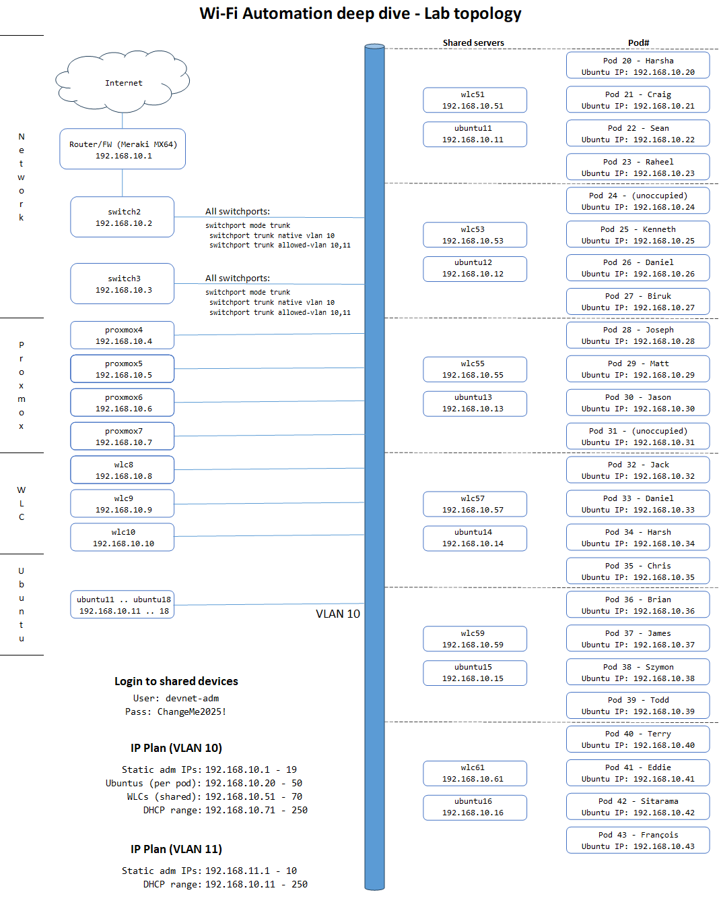

Lab topology
Each student have an assigned Pod number. When using static IP, their Ubuntu Server should have the same last octet as the Pod#
2 students share a preconfigured WLC, as assigned in the topology map
Everyone is connected to VLAN 10
All switchports on all switches are trunk ports with VLAN 10 as native, and allowed vlan as VLAN 10 and 11
For Wi-Fi clients on your SSIDs you can use VLAN 11 to not fill up VLAN 10

Slide 9
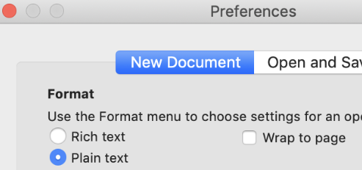
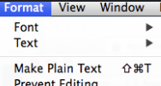
Notes for Mac users - TextEdit
Notes for Mac users
TextEdit (the default text editor on OS X) use rich text formatting by default. This is not a great idea when copy-pasting stuff to the command line, so there is a couple of things you must keep in mind
If you want, you can change a setting in TextEdit to make all new documents plain text
To change the current document to plain text go to Format -> Make Plain Text
Shortcut is: Shift-Cmd-T

Slide 10
Notes for WSL users (alternative, untested yet)
Notes for WSL users
You can use WSL (Windows Subsystem for Linux) instead of a Ubuntu VM running in a hypervisor, for Python and Ansible stuff
TIG stack and other docker stuff is not tested (yet)
No instructions for using WSL or adopting the lab guide to WSL is included at this moment
Install WSL (start Powershell as administrator)
Check WSL version
Upgrade WSL
Install Ubuntu, run "wsl --install -d Ubuntu
List installed WSL VMs, run "wsl --list"
Fix network connectivity (from Powershell. Restart WSL)
You might have to create some FW-openings and/or do some port forwarding to get the external devices (like the 9800 WLC) to communicate into your WSL Telegraf etc
PS C:\> echo '[wsl2]' > ~\.wslconfig
PS C:\> echo 'networkingMode=mirrored' >> ~\.wslconfig
PS C:\> wsl --install
PS C:\> wsl --version
WSL version: 2.3.24.0
(... if this command is not showing version, you must upgrade)
PS C:\> wsl --update
PS C:\> wsl --install -d Ubuntu
PS C:\> wsl --list

Slide 11
Building your own lab
Building your own lab
Based on feedback from running this deep dive on previous events, if you are going to build and troubleshoot the full lab setup, it will take most or all of the time (2x 3h)
The deep dive itself will have pre-built and pre-configured+tested WLAN Controllers (1 WLC per 2-4 students) for you to use. If you want to install your own WLC by following the optional part of this pre-lab guide that is OK, but we strongly encourage you to use the deep dive time to do actual automation exercises and not troubleshooting your WLC
There will also be pre-built Ubuntu servers to use, running on our servers, for those who want to use that instead of their own laptop.
If you have a mini computer or an old laptop to spare, you could install Proxmox on that and use for your VMs. Unfortunately it is outside the scope of this deep dive and this pre-lab guide to give detailed instructions on the Proxmox installation itself, outside what is described in task 1d. It is also outside the scope of the deep dive to help troubleshoot your Proxmox. But our servers run on that, so we are somewhat familiar with it and might answer some simple questions ☺
We will also provide pre-built images with a finished installation of Ubuntu Server for Hyper-V and Virtualbox
We encourage you to install your own Ubuntu Server, since it will give you more experience building the items yourself when you get home or need it in some other situation.

Slide 12
Tentative schedule for day 1
Tentative schedule
Hour 1
Introductions and getting started
Finish the pre-lab tasks
Get to know the lab environment
Install and explore Ansible
Hour 2
Explore Python automation
Explore YANG models
Explore Postman
Hour 3
Install and explore TIG-stack / Grafana

Slide 13
Lab exercise #0: Finish the pre-lab tasks
Lab exercise #0: Finish the pre-lab tasks
Get help to whatever you did not finish
There will probably (always) be some cases which falls outside what is tested

Slide 14
Lab exercise #1: Connect your laptop and Ubuntu
Lab exercise #2: Configure the AP
Connect your laptop to the wired network
Ensure you get DHCP in the range 192.168.10.71-250 /24
Ensure you get internet access through the wired connection
Boot up your Ubuntu VM
If using Multipass - Check that the bridged network is correct. Choose your USB dongle or ethernet port etc
Follow the next slide to change it to static IP
akoksrud:MacOS ~$ multipass networks
Name Type Description
en0 wifi Wi-Fi
en4 ethernet Ethernet Adapter (en4)
en5 ethernet Ethernet Adapter (en5)
en8 usb USB 10/100/1000 LAN
akoksrud:MacOS ~$ multipass set local.bridged-network=en8
akoksrud:MacOS ~$ multipass restart ubuntu-devnet

Slide 15
Pre-lab task #2: Ubuntu Server
Change from DHCP to static IP - MULTIPASS only
If you are using Multipass, it creates two network adapters. Please follow this guide if you are using Multipass. If NOT using multipass, follow the next slide
This will show one method to permanently change the IP of your server
Copy the netplan config file to a new file (remember sudo here)
Delete the auto-created /etc/netplan/50-cloud-init.yaml
Run "sudo netplan apply" to use the new config file
Check that you have the new IP
Reboot the server and you're good to go ☺
It looks like this (ish):
network:
version: 2
ethernets:
default:
match:
macaddress: "52:54:00:cb:dc:82"
dhcp-identifier: "mac"
dhcp4: true
extra0:
match:
macaddress: "52:54:00:8f:54:67"
optional: true
dhcp-identifier: "mac"
dhcp4: true
dhcp4-overrides:
route-metric: 200
~$ sudo cp /etc/netplan/50-cloud-init.yaml /etc/netplan/99_config.yaml
~$ sudo nano /etc/netplan/99_config.yaml
~$ sudo chmod 600 /etc/netplan/99_config.yaml
devnet-adm@ubuntu-devnet:~$ sudo rm /etc/netplan/50-cloud-init.yaml
devnet-adm@ubuntu-devnet:~$ sudo netplan apply
Change the "extra0" part
network:
version: 2
ethernets:
default:
match:
macaddress: "52:54:00:cb:dc:82"
dhcp-identifier: "mac"
dhcp4: true
extra0:
match:
macaddress: "52:54:00:8f:54:67"
dhcp4: false
addresses:
- 192.168.10.{YOUR_POD_IP}/24
routes:
- to: default
via: 192.168.10.1
nameservers:
addresses:
- 1.1.1.1
devnet-adm@ubuntu-devnet:~$ sudo netplan status
devnet-adm@ubuntu-devnet:~$ sudo reboot now
Change to YOUR Ubuntu IP

Slide 16
Pre-lab task #2: Ubuntu Server
!!! In YAML, indentation is REALLY important !!!
In this file I use 2, 4, 6 or 8 spaces (multiple of 2). It would be valid to use multiple of 3 or 4 instead.
Change from DHCP to static IP
When you come to WLPC you would need to use a static IP in the lab range. Before WLPC you might just keep the server in DHCP mode, and come back to this slide during the deep dive.
This will show one method to permanently change the IP of your server
Check your adapter name
Create a new file /etc/netplan/99_config.yaml
Delete the auto-created /etc/netplan/50-cloud-init.yaml
Run "sudo netplan apply" to use the new config file
Check that you have the new IP
Reboot the server and you're good to go ☺
Change to YOUR Ubuntu IP
Get this value from "netplan status". Enter it into 99_config.yaml
Probable values: - Proxmox: ens18 - Hyper-V: eth0 - VirtualBox: enp0s3
/etc/netplan/99_config.yaml
devnet-adm@ubuntu-devnet:~$ netplan status | grep network
2: ens18 ethernet UP (networkd: ens18)
network:
ethernets:
ens18:
# dhcp4: true
dhcp6: false
dhcp4: false
addresses:
- 192.168.10.{YOUR_POD_IP}/24
routes:
- to: default
via: 192.168.10.1
nameservers:
addresses:
- 1.1.1.1
devnet-adm@ubuntu-devnet:~$ sudo nano /etc/netplan/99_config.yaml
devnet-adm@ubuntu-devnet:~$ sudo chmod 600 /etc/netplan/99_config.yaml
devnet-adm@ubuntu-devnet:~$ sudo rm /etc/netplan/50-cloud-init.yaml
devnet-adm@ubuntu-devnet:~$ sudo netplan apply
devnet-adm@ubuntu-devnet:~$ sudo netplan status
Most Common errors:
Wrong file permissions (step 2)
Errors in the indentation in the YAML file
devnet-adm@ubuntu-devnet:~$ sudo reboot now
To easily change between static and DHCP, I just comment/uncomment the lines. To change this to DHCP, just unncomment the "dhcp4: true" line, and comment the rest

Slide 17
Lab exercise #2: Test the lab environment
Lab exercise #1: Get to know the lab environment
Access from your computer to the devices
SSH to one or more of the shared Ubuntu servers (192.168.10.11 up to .18)
SSH and HTTPS to your designated WLC (192.168.10.51, 53, 55, etc) shared with 3 other students
You have admin access to all shared devices, please don't mess up for each other ☺
Access from your Ubuntu Server to the devices
Ping from your Ubuntu VM to your designated WLC
Ping from your Ubuntu VM to the Internet
Access in to your Ubuntu Server
Ping from your designated WLC to your Ubuntu VM

Slide 18
Lab exercise #3: Explore VS Code
Lab exercise #3: Explore VS Code
We will now use our VS Code installation to open a directory on the Ubuntu server
Instructions will follow to
Open the "Remote-SSH" extension
Create new host
Connect current window to remote host
Install local extensions in remote host
Open a remote folder as workspace
Open some example files from the downloaded GIT repository

Slide 19
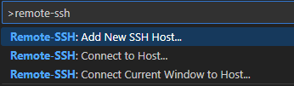
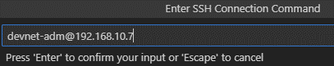
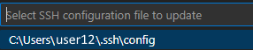
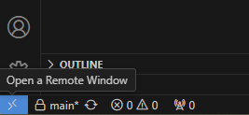
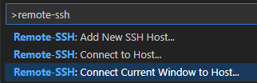
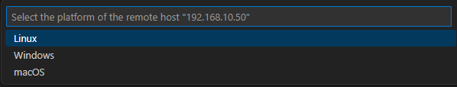
VS Code - Connect to... Remote SSH
Lab exercise #3: Explore VS Code
Replace with your Ubuntu IP
Command Palette (F1)
Type "remote-ssh", select "Add New SSH Host...", type "devnet-adm@192.168.10.7"
Connect to the new Host, either using lower left corner of VS Code window or Command Palette (F1)
When asked about platform type, select Linux

Slide 20
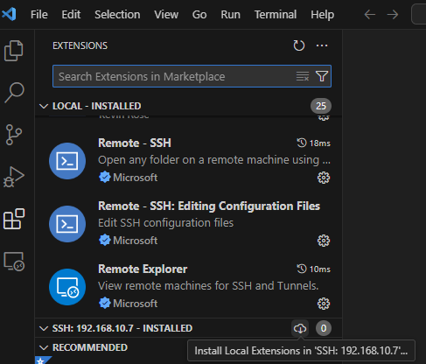
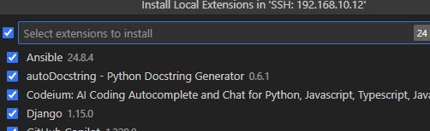
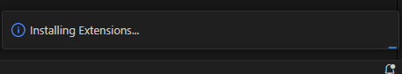
VS Code - Install Extensions in Remote SSH
Lab exercise #3: Explore VS Code
The extensions have to be installed in each remote environment
When asked which ones to install, you can select everything, or select some of them if you have a lot of extensions
It will take a minute or so to install the extensions in the server

Slide 21
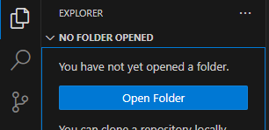
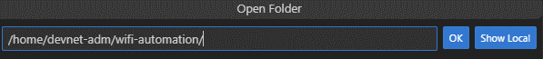
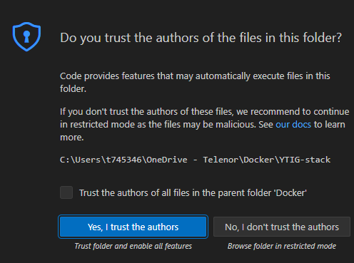
VS Code
Lab exercise #3: Explore VS Code
Open Folder
Trust authors

Slide 22
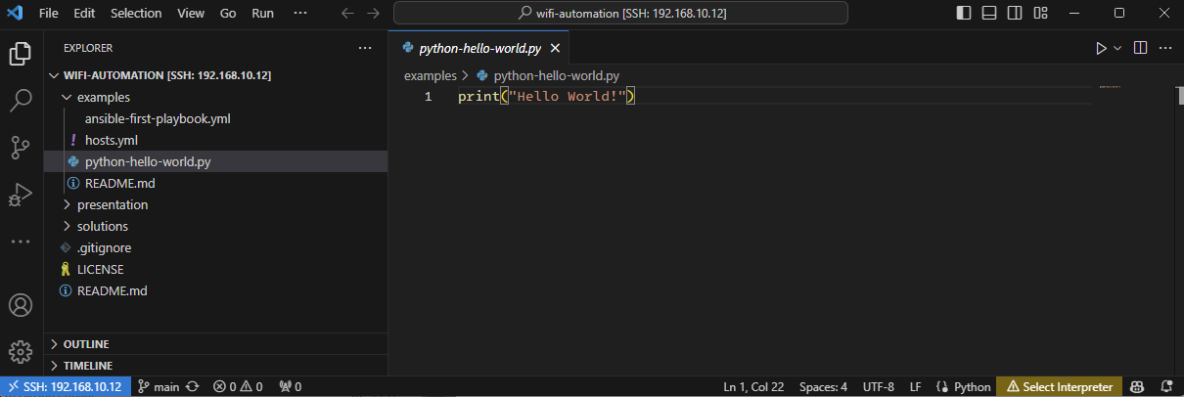
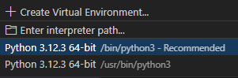
Lab exercise #3: Explore VS Code
Using Explorer in VS Code, open the example file python-hello-world.py
Detected language for active file
(can be manually overridden)
Active Python environment
for active file. Press here, and
for now select one of the options,
like /bin/python3

Slide 23
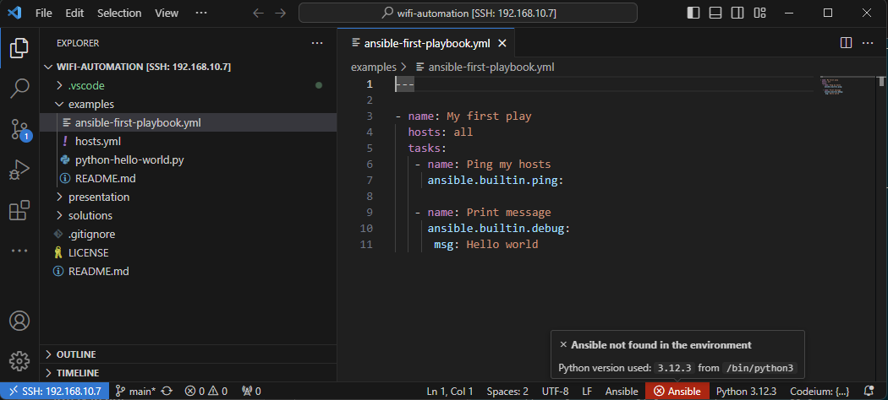
Lab exercise #3: Explore VS Code
If you open the Ansible file ansible-first-playbook.yml some errors will show. We will fix this later in the lab, after installing Ansible

Slide 24
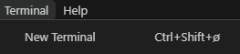
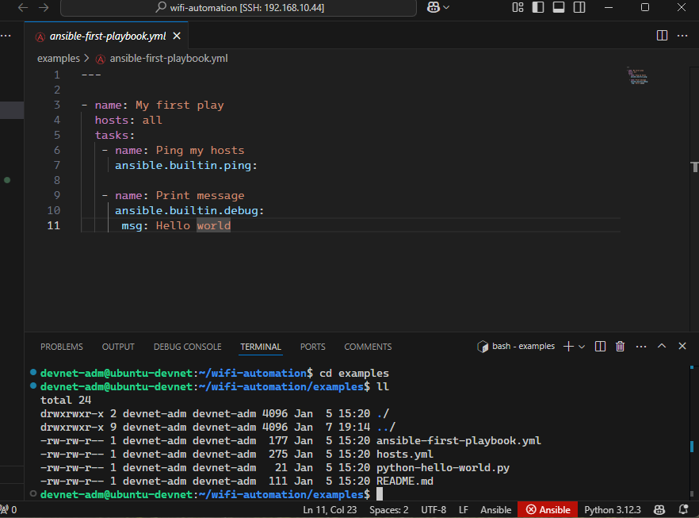
Terminal in VS Code
Lab exercise #3: Explore VS Code
VS Code has an integrated terminal you can use. In many cases this is a convenient way to SSH to your server when working on projects in VS Code
Select "Terminal" and "New Terminal" You can also use the shortcut (sorry again for the stupid Norwegian characters ☺)
The code window will split, and you will have a terminal in the lower half (I usually use a larger window than in this screenshot, it's just resized to show it all on the same screenshot

Slide 25
Lab exercise #4: Install Ansible
Lab exercise #4: Install Ansible
In this exercise, we will
Create a Python virtual environment to use for Ansible stuff
Install Ansible on the Ubuntu Server
Configure VS Code to use Ansible on the remote server
The first couple of slides will explain briefly about Ansible (for your reference)
Then the installation process is explained step by step, before re-opening the first playbook example

Slide 26
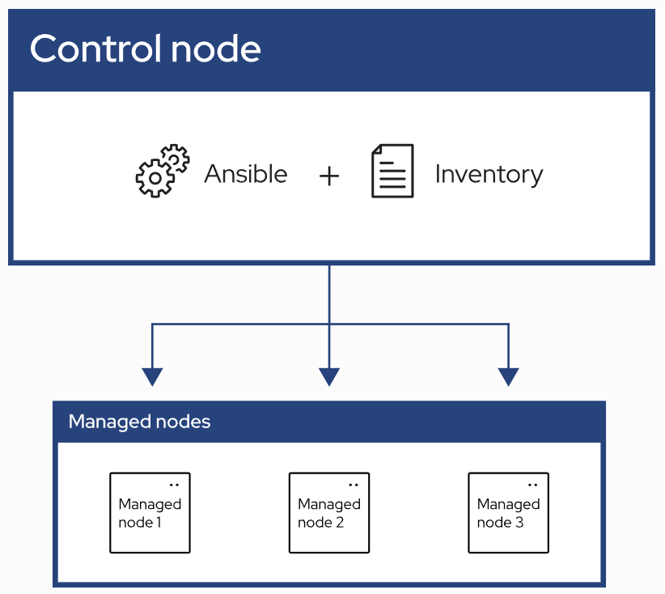
What is Ansible
Lab exercise #4: Install Ansible
Automation using "playbooks" written in YAML format
Agent-less architecture
No installation on the managed nodes
Idempotency
Does not change/write if target is already in state described by playbook
Control node
System where Ansible is installed and runs the playbooks
Inventory
List of managed nodes where the playbook will affect
Managed nodes
Remote systems that are the targets of your playbooks

Slide 27
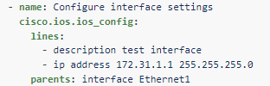
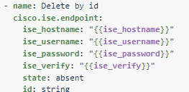
Plugins and modules
Lab exercise #4: Install Ansible
Plugins
Extends the core functionality of Ansible
Examples
cisco.ios.ios cliconf - To run CLI commands on Cisco IOS device
Become plugins, how to get write access on various systems ("sudo", "enable" etc)
Connection plugins, like SSH
Modules
Built-in or custom code snippets to perform various tasks
A special type of plugin
Examples
cisco.ios.ios_config
cisco.ise.endpoint

Slide 28
Ansible installation
Lab exercise #4: Install Ansible
Installing in a Python VENV (Virtual Environment)
(optional info) Ansible could be installed globally. But by using VENV we can control the environment more closely. Most projects will have some dependencies, and by controlling the environment you ensure that the packages in the environment are ones that is tested to be compatible with the project. Here we just use the latest, but it is shared to list ("freeze") the currently installed packages and versions from an environment when tested OK, and use this as a requirements input when reproducing the environment
devnet-adm@ubuntu-devnet:~$ sudo apt install pip python3-venv
devnet-adm@ubuntu-devnet:~$ mkdir ~/automation-venv
devnet-adm@ubuntu-devnet:~$ python3 -m venv ~/automation-venv/
devnet-adm@ubuntu-devnet:~$ source ~/automation-venv/bin/activate
(automation-venv) devnet-adm@ubuntu-devnet:~$ pip install ansible ansible-lint
(automation-venv) devnet-adm@ubuntu-devnet:~$ ansible --version
ansible [core 2.17.1]
config file = None
configured module search path = ['/home/devnet-adm/.ansible/plugins/modules', '/usr/share/ansible/plugins/modules']
ansible python module location = /home/devnet-adm/automation-venv/lib/python3.12/site-packages/ansible
ansible collection location = /home/devnet-adm/.ansible/collections:/usr/share/ansible/collections
executable location = /home/devnet-adm/automation-venv/bin/ansible
python version = 3.12.3 (main, Apr 10 2024, 05:33:47) [GCC 13.2.0] (/home/devnet-adm/automation-venv/bin/python3)
jinja version = 3.1.4
libyaml = True
(automation-venv) devnet-adm@ubuntu-devnet:~$

Slide 29
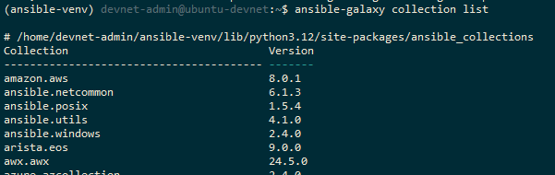
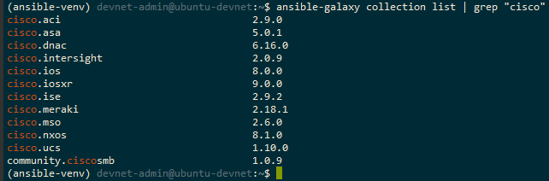
Ansible Collections
Lab exercise #4: Install Ansible
A collection is a premade collection of playbooks, roles, modules and plugins, usually for a specific purpose or type of devices
https://docs.ansible.com/ansible/latest/collections/index.html#list-of-collections
This is how to look up which collections you have installed in your environment

Slide 30
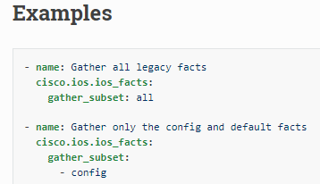
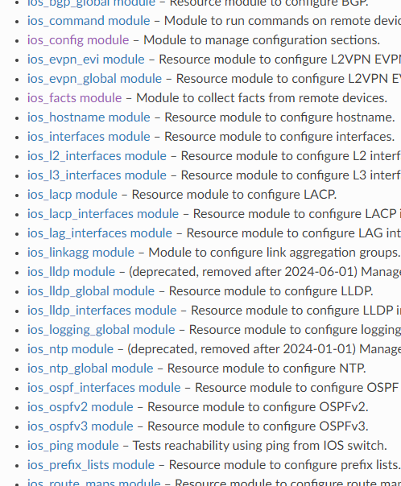
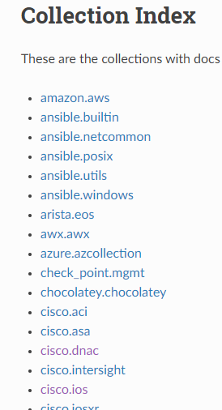
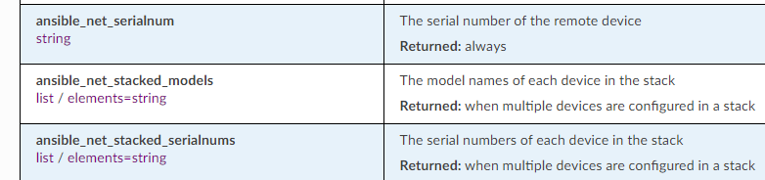
Ansible Collections
Lab exercise #4: Install Ansible
Navigating the documentation
https://docs.ansible.com/ansible/latest/collections/index.html#list-of-collections

Slide 31
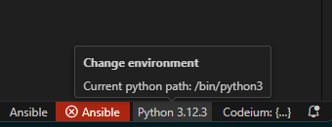
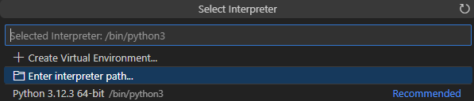
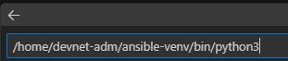
VS Code - Python environment for Ansible
Lab exercise #4: Install Ansible
Check which Python environment is used by Ansible
Select python environment (VS Code, bottom line)
Select «Enter interpreter path...»
Enter the python environment that Ansible use, into this line and press Enter
Bottom line should now show the Ansible version (2.18.1) and Python version and venv
devnet-adm@ubuntu-devnet:~$ source ~/automation-venv/bin/activate
(automation-venv) devnet-adm@ubuntu-devnet:~$ ansible --version | grep "python version"
python version = 3.12.3 (main, Apr 10 2024, 05:33:47) [GCC 13.2.0] (/home/devnet-adm/automation-venv/bin/python3)
!! Common mistake: !!
Do not type here…
Press here.
Then type here…
/home/devnet-adm/automation-venv/bin/python3

Slide 32
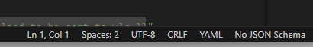
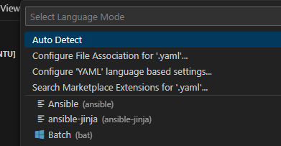
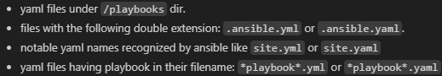
VS Code - Choose file type
Lab exercise #4: Install Ansible
If not auto detected, file type can be changed for open files
Pro tip: If the file name contains the word «playbook», it will automatically be recognized as Ansible by VS Code (and not general YAML)
interface-playbook.yaml
demo-playbook.yaml
There are also other ways to get VS Code to auto recognize playbooks, like putting them in a "playbooks" subfolder

Slide 33
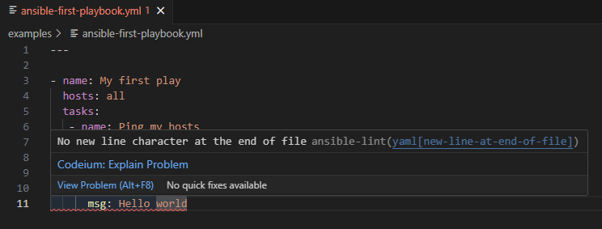
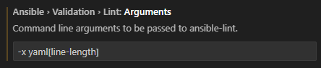
Ansible-lint
Lab exercise #4: Install Ansible
Linting (syntax checking) is done on file save
The «ansible-first-playbook.yml» should have an error that shows on first save, when ansible-lint runs in the background
Try to fix this yourself ☺
(optional info) You can also specify ansible-lint to exclude certain errors, like the "line too long" error.
Open Settings (Ctrl-,) and search for "ansible-lint" Enter -x yaml[line-length]

Slide 34
Lab exercise #5: Explore Ansible
Lab exercise #5: Explore Ansible
In this lab, you will be given a simple example to get you started with Ansible
The Ansible section of Day2 will include more exercises for you to do, including example solutions

Slide 35
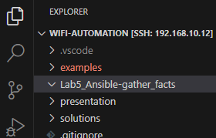
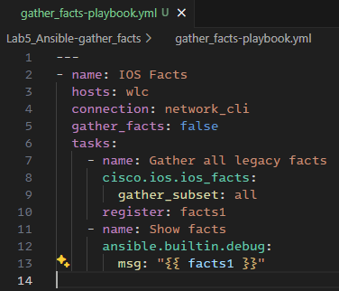
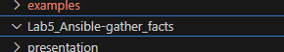

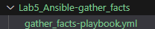
Gather facts
Lab exercise #5: Explore Ansible
gather_facts-playbook.yml
---
- name: IOS Facts
hosts: wlc
connection: network_cli
gather_facts: false
tasks:
- name: Gather all legacy facts
cisco.ios.ios_facts:
gather_subset: all
register: facts1
- name: Show facts
ansible.builtin.debug:
msg: "{{ facts1 }}"
Create a folder
Shows up automatically in VS Code
Create files and folders in VS Code, right click to get menu
Create the file "gather_facts-playbook.yml"
Copy-paste from this textbox to VS Code
(automation-venv) devnet-adm@ubuntu-devnet:~/wifi-automation$ mkdir Lab5_Ansible-gather_facts

Slide 36
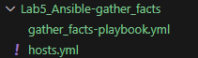
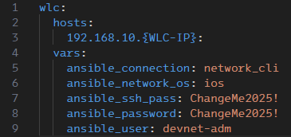
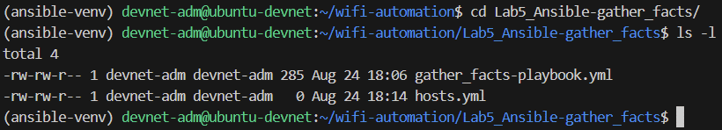
Ansible hosts file
Lab exercise #5: Explore Ansible
hosts.yml
wlc:
hosts:
192.168.10.{WLC-IP}:
vars:
ansible_connection: network_cli
ansible_network_os: ios
ansible_ssh_pass: ChangeMe2025!
ansible_password: ChangeMe2025!
ansible_user: devnet-adm
Let’s create a file named hosts.yml
It shows up in the folder as well
Change to YOUR
WLC IP

Slide 37
Fix dependencies
Lab exercise #5: Explore Ansible
Try to run the playbook with the following command. Something is missing.
(automation-venv) devnet-adm@ubuntu-devnet:~/wifi-automation/Lab5_Ansible-gather_facts$ ansible-playbook -i hosts.yml gather_facts-playbook.yml
PLAY [IOS Facts] ***************************************************************************************************************************************
TASK [Gather all legacy facts] *************************************************************************************************************************
[WARNING]: ansible-pylibssh not installed, falling back to paramiko
fatal: [192.168.10.30]: FAILED! => {"changed": false, "msg": "paramiko is not installed: No module named 'paramiko'"}
PLAY RECAP *********************************************************************************************************************************************
192.168.10.30 : ok=0 changed=0 unreachable=0 failed=1 skipped=0 rescued=0 ignored=0
(automation-venv) devnet-adm@ubuntu-devnet:~/wifi-automation/Lab5_Ansible-gather_facts$
Let's install "ansible-pylibssh"
First, make sure you are in your automation-venv
If it is not showing (automation-venv) at the start of the line, enter source ~/automation-venv/bin/activate
Then install the package in your venv by using "pip install {package name}
(automation-venv) devnet-adm@ubuntu-devnet:~$ pip install ansible-pylibssh
Collecting ansible-pylibssh
Downloading ansible_pylibssh-1.2.2-cp312-cp312-manylinux_2_28_x86_64.whl.metadata (36 kB)
Downloading ansible_pylibssh-1.2.2-cp312-cp312-manylinux_2_28_x86_64.whl (2.9 MB)
━━━━━━━━━━━━━━━━━━━━━━━━━━━━━━━━━━━━━━━━ 2.9/2.9 MB 7.1 MB/s eta 0:00:00
Installing collected packages: ansible-pylibssh
Successfully installed ansible-pylibssh-1.2.2
(automation-venv) devnet-adm@ubuntu-devnet:~$

Slide 38
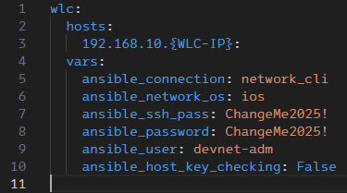
SSH host key checking
Lab exercise #5: Explore Ansible
Try running again. The SSH connection is failing
Update the hosts.yml file
(automation-venv) devnet-adm@ubuntu-devnet:~/wifi-automation/Lab5_Ansible-gather_facts$ ansible-playbook -i hosts.yml gather_facts-playbook.yml
PLAY [IOS Facts] ***************************************************************************************************************************************
TASK [Gather all legacy facts] *************************************************************************************************************************
fatal: [192.168.10.30]: FAILED! => {"changed": false, "msg": "\nlibssh: The authenticity of host '192.168.10.30' can't be established due to 'Host is unknown: 41:86:3e:e4:fb:9f:de:06:5b:72:f3:ce:75:f1:da:ad:e7:a5:13:c0'.\nThe ssh-rsa key fingerprint is SHA1:QYY+5Puf3gZbcvPOdfHareelE8A."}
PLAY RECAP *********************************************************************************************************************************************
192.168.10.30 : ok=0 changed=0 unreachable=0 failed=1 skipped=0 rescued=0 ignored=0
Change to YOUR
WLC IP
hosts.yml
wlc:
hosts:
192.168.10.{WLC-IP}:
vars:
ansible_connection: network_cli
ansible_network_os: ios
ansible_ssh_pass: ChangeMe2025!
ansible_password: ChangeMe2025!
ansible_user: devnet-adm
ansible_host_key_checking: False

Slide 39
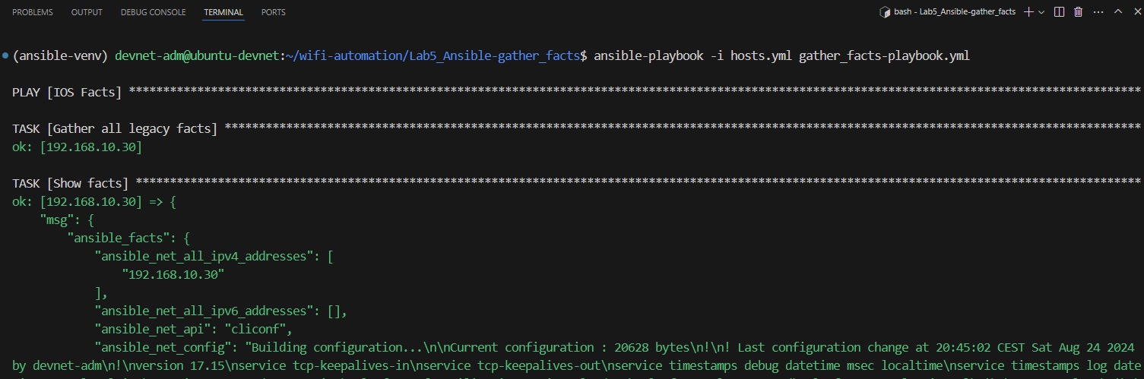
Gather facts
Lab exercise #5: Explore Ansible
Successful play

Slide 40
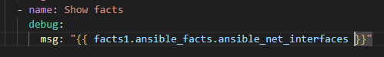
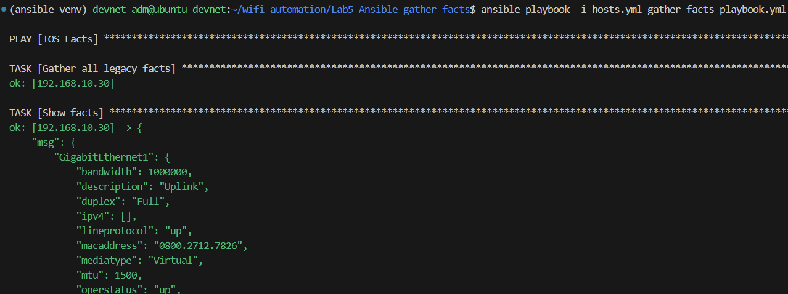
Use parts of return values
Lab exercise #5: Explore Ansible
The returned facts1 is a dictionary
You can use dot notation
Edit the "Show facts" task, to show only some subset of the info
- name: Show facts
debug:
msg: "{{ facts1.ansible_facts.ansible_net_interfaces }}"

Slide 41
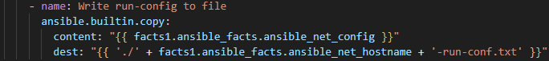
Use return values
Lab exercise #5: Explore Ansible
gather_facts-playbook.yml
---
- name: IOS Facts
hosts: wlc
connection: network_cli
gather_facts: no
tasks:
- name: Gather all legacy facts
cisco.ios.ios_facts:
gather_subset: all
register: facts1
- name: Write run-config to file
ansible.builtin.copy:
content: "{{ facts1.ansible_facts.ansible_net_config }}"
dest: "{{ './' + facts1.ansible_facts.ansible_net_hostname + '-run-conf.txt' }}"
We will use the returned facts, to write the run-config to a file
Remove the "Show facts" task, and replace it with a new task
Using the "copy" module
Content is using parts of the return values, this time we use "ansible_net_config"
Dest is where to write the content. Here are some simple examples on Jinja syntax
(optional info)
Jinja2 is integrated in Ansible and widely used
"Everything inside double curly brackets" = Jinja2

Slide 42
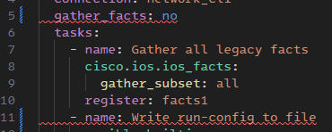


Linting errors, and fixing them
Lab exercise #5: Explore Ansible
gather_facts-playbook.yml
---
- name: IOS Facts
hosts: wlc
connection: network_cli
gather_facts: false
tasks:
- name: Gather all legacy facts
cisco.ios.ios_facts:
gather_subset: all
register: facts1
- name: Write run-config to file
ansible.builtin.copy:
content: "{{ facts1.ansible_facts.ansible_net_config }}"
dest: "{{ './' + facts1.ansible_facts.ansible_net_hostname + '-run-conf.txt' }}"
mode: "0600"
When saving this file you should get two linting errors
We fix this with using "false" instead of "no"
Both will work, but correct YAML syntax is "false"
When writing files (like using the "copy" module), you should always explicitly specify the file permissions
We add the line: mode: "0600"

Slide 43




Run the playbook
Lab exercise #5: Explore Ansible
List the files, and you can see the file that was created
You can view the file contents in the Linux terminal by running "cat", "more", "nano" or similar
You will also see the file in VS Code explorer and can open it from there

Slide 44
Lab exercise #6: Explore YANG models
Lab exercise #6: Explore YANG models
First there will be a couple of slides to explain what YANG models are
Then you will explore some of the YANG models of the 9800 WLAN Controller by using the https://yangcatalog.org website
Lab 7 will explore YANG models using another tool (YANG Suite)
Some of the later labs will have optional parts where you can look up RESTCONF paths that you need using one of these tools

Slide 45

What is a YANG-model?
Lab exercise #6: Explore YANG models
Structured representation of cfg og oper data
Used primarily with NETCONF & RESTCONF
Do you recognize what the tree is showing?
Reference/download: https://github.com/YangModels/yang/tree/main/vendor/cisco/xe/1751

Slide 46



yangcatalog
Lab exercise #6: Explore YANG models
Open the following website: https://www.yangcatalog.org/
Select "Module Detail Viewer"
Here you can start typing parts of available YANG modules. Start by typing "IOS-XE-wireless". It is not case sensitive by the way
Select the AP oper module "Cisco-IOS-XE-wireless-access-point-oper" and click "Get details"
Then click "Tree View"

Slide 47

YANG Catalog - Navigating the Tree View
Lab exercise #6: Explore YANG models
Expand/collapse all nodes
Expand/collapse this branch
This is a container/list node
Contains other nodes
Hover the mouse over an element name to get the description popup
This is a leaf node
Contains a single value
!! There are lots of info to the right of this screenshot. Sometimes the horizontal scroll bar is trying to hide, scroll down to the bottom to find it !!

Slide 48

Using values from YANG Catalog
Lab exercise #6: Explore YANG models
When navigating the tree view, here is where you find the values you will typically use, with examples
"Path": Used when configuring 9800 to send values as streaming telemetry. We will use this in lab 10 & 11 to configure WLC to send specific data to be visualized in Grafana
"Sensor Path": Used when you need a RESTCONF path. We will use this in the labs 8 (Postman), 9 (Python) and in many of the Day 2 labs (both Python and Ansible labs)
Use this for WLC telemetry config
Use this for RESTCONF path
no telemetry ietf subscription 4
telemetry ietf subscription 4
encoding encode-kvgpb
filter xpath /wireless-access-point-oper:access-point-oper-data/wireless-access-point-oper:radio-oper-data
stream yang-push
update-policy periodic 500
receiver ip address 192.168.10.7 57000 protocol grpc-tcp
do show telemetry ietf subscription 4

Slide 49

yangcatalog
Lab exercise #6: Explore YANG models
You can also get the tree view in a text form like this
Go to YANG Module Detail Viewer again, Search and find your module, and select "Get details"
A way down in the details table you will find "yang-tree", click the link there
The tree will open in a separate page

Slide 50


Lab exercise #7: Explore YANG Suite
Lab exercise #7: Explore YANG Suite
YANG Suite is an installable tool that can be used to pull supported YANG models directly from the actual devices
You can also use it to test communication to your device using RESTCONF and more

Slide 51
Lab exercise #7: Explore YANG Suite
Lab exercise #7: Explore YANG Suite
!!! NOTE !!! You will explore YANG Suite using one of the servers where it is pre-installed. The installation has some bindings to the IP of the server, so it should be installed when you have the permanent static IP of your server
If you want to install it on your own VM, the instructions are included in the optional Lab Exercise #12, beware that it will take a little while so you might want to do it later instead of during the deep dive
In the pre-installed servers, YANG models will already be pulled from one of the pre-installed WLCs
To get an even distribution, you can spread so that if you have the following WLC, use the following Ubuntu Servers to explore YANG Suite:
If YANG-Suite is not running on any of those machines, start it with the following commands
Shared WLC | Shared Ubuntu Server | YANG Suite URL
wlc51 (192.168.10.51) | ubuntu11 (192.168.10.11) | https://192.168.10.11:8443
wlc53 (192.168.10.53) | ubuntu12 (192.168.10.12) | https://192.168.10.12:8443
wlc55 (192.168.10.55) | ubuntu13 (192.168.10.13) | https://192.168.10.13:8443
wlc57 (192.168.10.57) | ubuntu14 (192.168.10.14) | https://192.168.10.14:8443
wlc59 (192.168.10.59) | ubuntu15 (192.168.10.15) | https://192.168.10.15:8443
wlc61 (192.168.10.61) | ubuntu16 (192.168.10.16) | https://192.168.10.16:8443
devnet-adm@ubuntu-devnet:~$ cd ~/yangsuite/docker
devnet-adm@ubuntu-devnet:~$ docker compose up -d

Slide 52


YANG Suite
Lab exercise #7: Explore YANG Suite
«oper» -> Operational data
«cfg» -> Configuration and config data
Log in to a YANG Suite (URL on previous slide)
Go to Explore -> YANG -> Select a YANG. Select a YANG model and click the "Load module(s)" button

Slide 53

Lab exercise #7: Explore YANG Suite
Lab exercise #7: Explore YANG Suite
This is the info you typically use to craft RESTCONF calls (Postman, Python, Ansible, etc) or streaming telemetry subscriptions (from WLC)
Explore YANG Models

Slide 54


Lab exercise #7: Explore YANG Suite
Lab exercise #7: Explore YANG Suite
Over the next pages is examples on a couple more YANG models you can check out
Get AP summary
Get Clients
Just get somewhat familiar, you will use these in the next lab exercises (Postman, Python, Ansible, Grafana)
This will show you the model, not pull the actual data
To pull data we will use these models i Postman and Grafana later
(optional) You can also do RESTCONF and NETCONF calls to the device from YANG Suite
Protocols -> RESTCONF -> Find your module -> Generate API(s) -> Authorize -> Try it out -> Execute

Slide 55

Get AP summary
Lab exercise #7: Explore YANG Suite

Slide 56

Get Client summary
Lab exercise #7: Explore YANG Suite

Slide 57
Lab exercise #8: Explore Postman
Lab exercise #8: Explore Postman
In this lab exercise we will
Create a Workspace
Create an Environment
Create a Collection
Test some queries found from yangcatalog.org or YANG Suite (any of your choice)
Output to CURL or Python

Slide 58

Overview
Lab exercise #8: Explore Postman
1
2
3
Here is an example view of Postman and how the YANG modules from previous exercises can look here. We will test and explain this in more detail in this exercise
RESTCONF path
YANG module
Xpath
Postman is a "go-to" tool for RESTCONF APIs. Some examples for automation is testing and validating RESTCONF calls to IOS-XE devices before implementing in Python, Ansible, etc.

Slide 59

Launching Postman
Lab exercise #8: Explore Postman
Start by launching Postman. You should already be logged in from the pre-lab task. If not, log in now. It might look something like this

Slide 60




Create Workspace
Lab exercise #8: Explore Postman

Slide 61





Create Environment
Lab exercise #8: Explore Postman
Activate the new environment ... and create some variables
!! Remember to save !!
Values in this column are synced to your Postman account
Values in this column are stored locally in Postman on your PC

Slide 62


A word about saving
Lab exercise #8: Explore Postman
This little orange dot means the file/tab/whatever is not saved
Use Ctrl+S to save the current tab, or click this icon
An example: When you run a RESTCONF call with variables from an environment, like {{host}} or {{password}} it will use the value from your SAVED file. So if you do changes in the environment, remember to save the tab

Slide 63



Create Collection
Lab exercise #8: Explore Postman
!! Remember to save !!
Select "Collections"
Click the +, create a Blank collection
Rename the collection
Click "Authorization" select "Basic Auth" Enter Username and Password like this
Creating the variables like this will make Postman get them from the current active environment (that we just created)

Slide 64




Creating your first Request
Lab exercise #8: Explore Postman
In the "Collections" tab and on the "Cisco C9800" collection you created in last step, Add a new request by either
Right clicking "Cisco C9800"
Clicking "Add a request" if you haven't created any before
Clicking the three dots on the "Cisco C9800" line
Then select "Add request"
Name the new request "Get config"
Write your Request on the top line, default starting with "GET" and empty line
The next slides will give example of creating requests using yangcatalog and YANG Suite, with some alternative slide layouts/explanations

Slide 65






Get config
Lab exercise #8: Explore Postman
Create the Request based on the information explored from https://yangcatalog.org
Expand the tree until you find your module
Base restconf path: https://{{host}}/restconf/data
Add the "Sensor Path" to the base path
Write the path in Postman
Go to "Headers" and enter the following
Press "Send" and you should get a response similar to this
https://{{host}}/restconf/data/Cisco-IOS-XE-native:native

Slide 66


Get config (YANG Suite alternative)
Lab exercise #8: Explore Postman
Here is an example of how to craft the same Request based on info you find in YANG Suite
Base Restconf path: https://{{host}}/restconf/data/
YANG-module: Cisco-IOS-XE-native
Xpath: native
Combined request path for copy-paste:
Write the path in Postman
Go to "Headers" and enter the following
Press "Send" and you should get a response similar to this
Use colon (:) instead of forward slash (/) in the Xpath
You may get some line breaks at the end. Remove them before sending the request
https://{{host}}/restconf/data/Cisco-IOS-XE-native:native

Slide 67


Get AP Summary (yangcatalog)
Lab exercise #8: Explore Postman
Create the Request based on the information explored from https://yangcatalog.org
Expand the tree until you find your module
The middle of the webside is cut away, since it is too wide to show on this slide
Base restconf path: https://{{host}}/restconf/data
Copy the Sensor Path after the base restconf path, then create the rest of the query as the instructions from the previous slides
https://{{host}}/restconf/data/Cisco-IOS-XE-wireless-access-point-oper:access-point-oper-data/capwap-data

Slide 68




Get AP summary (YANG Suite)
Lab exercise #8: Explore Postman
Here is an example of how to craft the same Request based on info you find in YANG Suite
Restconf path: https://{{host}}/restconf/data/
YANG-module: Cisco-IOS-XE-wireless-access-point-oper
Xpath: access-point-oper-data/capwap-data
Combined request path for copy-paste:
https://{{host}}/restconf/data/Cisco-IOS-XE-wireless-access-point-oper:access-point-oper-data/capwap-data

Slide 69


Get Client Summary (yangcatalog)
Lab exercise #8: Explore Postman
Create the Request based on the information explored from https://yangcatalog.org
Expand the tree until you find your module
Base restconf path: https://{{host}}/restconf/data
Copy the Sensor Path after the base restconf path, then create the rest of the query as the instructions from the previous slides
https://{{host}}/restconf/data/Cisco-IOS-XE-wireless-client-oper:client-oper-data/common-oper-data

Slide 70

Get client summary (YANG Suite)
Lab exercise #8: Explore Postman
Here is an example of how to craft the same Request based on info you find in YANG Suite
Restconf path: https://{{host}}/restconf/data/
YANG-module: Cisco-IOS-XE-wireless-client-oper
Xpath: client-oper-data/shared-oper-data
Combined request path for copy-paste:
https://{{host}}/restconf/data/Cisco-IOS-XE-wireless-client-oper:client-oper-data/common-oper-data
RESTCONF path
YANG module
Xpath
If no users are connected, the return is "No Content" (status code 204)

Slide 71





Output to Python
Lab exercise #8: Explore Postman
You can output the RESTCONF call as various code snippets by clicking the "Code" button
This can be used in your favorite Python editor, or just run it to test
You get this by hovering the mouse over the **** text in the Code snippet
Add "verify= False" to skip certificate checking on the host

Slide 72
Lab exercise #9: Explore Python automation
Lab exercise #9: Explore Python automation
In this exercise we will
Use the virtual environment "automation-venv" created in Lab 4
Connect VS Code to the Ubuntu server
Create a Python script that
Connects to the WLC using RESTCONF
Gets a table of currently connected APs on the WLC
Saves the AP list as an Excel file

Slide 73
Create Python venv
Lab exercise #9: Explore Python automation
This lab will use the same venv for Python and Ansible automation. It could be different, and scaling to production and prototyping could often mean having a venv per project
If you did not do Lab 4, here is a copy of the commands where we created the venv. If you have created and activated your venv already these commands will not do anything (except throw some error messages)
devnet-adm@ubuntu-devnet:~$ source ~/automation-venv/bin/activate
(automation-venv) devnet-adm@ubuntu-devnet:~$ python --version
Python 3.12.3
(automation-venv) devnet-adm@ubuntu-devnet:~$ cd wifi-automation
(automation-venv) devnet-adm@ubuntu-devnet:~/wifi-automation$
devnet-adm@ubuntu-devnet:~$ sudo apt install pip python3-venv
devnet-adm@ubuntu-devnet:~$ mkdir ~/automation-venv
devnet-adm@ubuntu-devnet:~$ python3 -m venv ~/automation-venv/
devnet-adm@ubuntu-devnet:~$ source ~/automation-venv/bin/activate
(automation-venv) devnet-adm@ubuntu-devnet:~$ python --version

Slide 74






Connect VS Code to the Ubuntu Server
Lab exercise #9: Explore Python automation
Use VS Code remote to the Ubuntu Server (if you are not connected already)
Press the Remote SSH icon (lower left corner)
Then, in the top line, select "Connect current window to Host..."
Select your host, or configure a new (see Lab 3)
Select "Open Folder" in the Explorer section
Select "/home/devnet-adm/wifi-automation/" and click OK
Open the "examples/python-hello-world.py"
Select the "automation-venv" venv: Click the Python version area on the bottom line

Slide 75

Create the Python file
Lab exercise #9: Explore Python automation
Create a folder "Lab9_Python-get-ap-table" and a python file "get-ap-table.py"
The new file will automatically open in the editor window

Slide 76

Prepare the RESTCONF calls
Lab exercise #9: Explore Python automation
Using Postman, test the RESTCONF calls to get this info from your WLC
This is the URL of the RESTCONF call we will be using in this exercise
https://{{host}}/restconf/data/Cisco-IOS-XE-wireless-access-point-oper:access-point-oper-data/capwap-data
You can try specifying some fields to reduce the data size
https://{{host}}/restconf/data/Cisco-IOS-XE-wireless-access-point-oper:access-point-oper-data/capwap-data?fields=wtp-mac;wtp-ip;name;ap-state;device-detail/static-info/board-data/wtp-serial-num;device-detail/static-info/board-data/wtp-enet-mac;device-detail/static-info/ap-models/model;tag-info/tag-source;tag-info/policy-tag-info;tag-info/site-tag;tag-info/rf-tag;tag-info/filter-info/filter-name;ap-time-info/boot-time;ap-time-info/join-time

Slide 77

Prepare Python packages
Lab exercise #9: Explore Python automation
Make sure you are in the "automation-venv", indicating by the text (automation-venv) before each line in the terminal. If not, you will get an error message
For this exercise, we will use the following modules
requests
pandas
openpyxl
To install these, use the command "pip install requests pandas openpyxl"
If you want, you can wait installing these until you see the errors highlighted in VS Code when we try to use them
(automation-venv) devnet-adm@ubuntu-devnet:~/wifi-automation$ cd Lab9_Python-get-ap-table
(automation-venv) devnet-adm@ubuntu-devnet:~/wifi-automation/Lab9_Python-get-ap-table$ pip install requests pandas openpyxl
Collecting requests
Downloading requests-2.32.3-py3-none-any.whl.metadata (4.6 kB)
Collecting pandas
Downloading pandas-2.2.2-cp312-cp312-manylinux_2_17_x86_64.manylinux2014_x86_64.whl.metadata (19 kB)
Collecting openpyxl
(...)
Successfully installed certifi-2024.7.4 charset-normalizer-3.3.2 et-xmlfile-1.1.0 idna-3.8 numpy-2.1.0 openpyxl-3.1.5 pandas-2.2.2 python-dateutil-2.9.0.post0 pytz-2024.1 requests-2.32.3 six-1.16.0 tzdata-2024.1 urllib3-2.2.2
(automation-venv) devnet-adm@ubuntu-devnet:~/wifi-automation/Lab9_Python-get-ap-table$

Slide 78

Get AP table
Lab exercise #9: Explore Python automation
get-ap-table.py
import requests
import pandas as pd
import getpass
wlc = input("Enter WLC IP: ")
user = input("Enter user: ")
password = getpass.getpass("Enter password: ")
url = f"https://{wlc}/restconf/data/Cisco-IOS-XE-wireless-access-point-oper:access-point-oper-data/capwap-data?fields=wtp-mac;wtp-ip;name;ap-state;device-detail/static-info/board-data/wtp-serial-num;device-detail/static-info/board-data/wtp-enet-mac;device-detail/static-info/ap-models/model;tag-info/tag-source;tag-info/policy-tag-info;tag-info/site-tag;tag-info/rf-tag;tag-info/filter-info/filter-name;ap-time-info/boot-time;ap-time-info/join-time"
payload = {}
headers = {
'Accept': 'application/yang-data+json',
'Content-Type': 'application/yang-data+json'
}
response = requests.get(url, auth=(user, password), headers=headers, data=payload, verify=False)
if (response.status_code==200):
ap_table = pd.json_normalize(response.json()['Cisco-IOS-XE-wireless-access-point-oper:capwap-data'])
print(ap_table)
ap_table.to_excel('ap_table.xlsx')
ap_table.to_csv('ap_table.csv')
else:
print(f"Status code: {response.status_code}: {response.reason}")
Import the modules we will use
WLC IP, username and password as input fields, it will be asked when running the script
Create the RESTCONF call using the IP of your WLC, and the path you tested with Postman
Make the call and save the response
Some very basic error checking
The response is given as JSON. We use a pandas function "json_normalize" to flatten parts of the JSON object to present it in a table
Print the table in the terminal
Save the table to Excel and CSV

Slide 79
Running the Python script from terminal
Lab exercise #9: Explore Python automation
One way to run a Python script, is by using the terminal. When in the folder of the script, run using "python" and the filename
(automation-venv) devnet-adm@ubuntu-devnet:~/wifi-automation$ cd Lab9_Python-get-ap-table
(automation-venv) devnet-adm@ubuntu-devnet:~/wifi-automation/Lab9_Python-get-ap-table$ ls -l
total 4
-rw-rw-r-- 1 devnet-adm devnet-adm 978 Aug 25 19:24 get-ap-table.py
(automation-venv) devnet-adm@ubuntu-devnet:~/wifi-automation/Lab9_Python-get-ap-table$ python get-ap-table.py
Enter WLC IP: 192.168.10.30
Enter user: devnet-adm
Enter password:
Use YOUR WLC IP
If there are no APs on the WLC it will have status code 204 (No Content). So it will not print the table etc, if it tried it would produce an error on the "json()[blablabla] part"
Status code: 204: No Content
Successful run will look something like this:
wtp-mac name wtp-ip ... ap-state.ap-operation-state ap-time-info.boot-time ap-time-info.join-time
0 4c:a6:4d:65:f9:40 9120E-ekms 192.168.10.182 ... registered 2024-07-25T00:28:12+00:00 2024-07-25T00:30:04.335182+00:00
1 d4:2c:44:d9:24:40 APD42C-44D8-2F38 192.168.10.177 ... registered 2024-07-31T19:22:07+00:00 2024-07-31T19:23:42.643078+00:00
Wrong username/password will look something like this:
Status code: 401: Unauthorized

Slide 80


Running the Python script from VS Code
Lab exercise #9: Explore Python automation
Press Ctrl+F5 to run the script in VS Code
Select "Python Debugger" if asked
The Excel file will contain the info, but will be otherwise unformatted. You can download the file by right-clicking it and selecting "Download…" and save to a folder of your choice on your local machine.
You can open the CSV file in VS Code, or in the terminal using "cat ap_table.csv" (or several alternatives)

Slide 81

Lab exercise #10: Install TIG stack (optional)
Lab exercise #10: Install TIG stack
!!! NOTE !!!
This exercise is marked as optional. However, if you plan on doing more Grafana stuff on day to we highly recommend that you do this, even if it will take some extra time today, or continue on to day 2
If you plan doing primarily Python or Ansible stuff on day 2, you can skip exercise 10 (installing TIG stack) and skip to Lab exercise 11. You can then use the installation on one of the pre-installed Ubuntu Servers.
In this lab exercise, we will install "TIG Stack" as a Docker container on the Ubuntu Server
As part of the installation we will
Create .env file containing variables
Ensure persistant storage
Create new bucket and adapt it so we can use InfluxDB
The next slides will give some basic overview of the TIG Stack, and how all fits together
T = Telegraf
I = InfluxDB
G = Grafana

Slide 82









TIG Stack overview
Lab exercise #10: Install TIG stack
gRPC / TCP 57000
C9800
metrics goes to the database
Wow!
TCP 8086
Grafana to visualize
WebUI - server:3000
TCP 3000

Slide 83



The TIG in the TIG stack
Lab exercise #10: Install TIG stack
Open Source Agent: Collects and sends metrics from databases, systems, and IoT devices
Versatile Monitoring: Works with databases, systems, and IoT sensors
Time Series Data at Scale: Store and query large volumes of time-stamped data
Real Time Analytics: Fast processing for immediate insights
Seamless Integration: Compatible with various tools and platforms
Visualize Anything: Create dashboards for any data
Real Time Insights: Customizable, interactive visuals
Flexible Integration: Connects to multiple data sources

Slide 84



Different flavours of Influx
Lab exercise #10: Install TIG stack
InfluxDB 2.x - FLUX
InfluxDB 1.x - InfluxQL
We will use InfluxDB 2.x but query data using InfluxQL
InfluxDB 3.x – InfluxQL (v2)

Slide 85
Make some notes
Lab exercise #10: Install TIG stack
There are some variables that need to be typed later, so to save time you can make a .txt file while we continue in this lab
Even better, you could use your favorite password manager (KeePass etc)
Lab10_Notes.txt
Admin token: {we will fill in this later}
Org ID: {we will fill in this later}
Container ID: {we will fill in this later}

Slide 86

TIG stack installation
Lab exercise #10: Install TIG stack
telegraf.conf
[global_tags]
host = "My-Telegraf"
[agent]
interval = "10s"
round_interval = true
metric_batch_size = 1000
metric_buffer_limit = 10000
collection_jitter = "0s"
flush_interval = "10s"
flush_jitter = "0s"
precision = ""
debug = false
quiet = false
logfile = ""
hostname = "My-Telegraf"
omit_hostname = false
###############################################################################
# OUTPUT PLUGINS #
###############################################################################
# Configuration for influxdb server to send metrics to
[[outputs.influxdb_v2]]
urls = [ "http://influxdb:8086" ]
token = "${INFLUXDB_ADMIN_TOKEN}"
organization = "${INFLUXDB_ORG}"
bucket = "${INFLUXDB_BUCKET}"
# tagexclude = ["influxdb_database"] ### Optional: Exclude specific tags if needed
[outputs.influxdb_v2.tagpass]
influxdb_database = ["${INFLUXDB_BUCKET}"]
###############################################################################
# INPUT PLUGINS #
###############################################################################
[[inputs.cisco_telemetry_mdt]]
transport = "grpc"
service_address = ":57000"
[inputs.cisco_telemetry_mdt.tags]
influxdb_database = "${INFLUXDB_BUCKET}"
Create a .env file to store variables
Add the INFLUXDB_ADMIN_TOKEN to your .txt file
Create persistent storage
Create the Telegraf config file
devnet-adm@ubuntu-devnet:~$ cd ~
devnet-adm@ubuntu-devnet:~$ mkdir tig-stack
devnet-adm@ubuntu-devnet:~$ cd tig-stack
devnet-adm@ubuntu-devnet:~/tig-stack$ nano .env
!
#add the following, and change the variables if needed
!
.env
INFLUXDB_ADMIN_USER=devnet-adm
INFLUXDB_ADMIN_PASSWORD=ChangeMe2025!
INFLUXDB_ORG=devnet
INFLUXDB_BUCKET=c9800-bucket
INFLUXDB_ADMIN_TOKEN=ChangeMe2025!
GF_SECURITY_ADMIN_USER=devnet-adm
GF_SECURITY_ADMIN_PASSWORD=ChangeMe2025!
devnet-adm@ubuntu-devnet:~/tig-stack$ docker volume create grafana-data
devnet-adm@ubuntu-devnet:~/tig-stack$ docker volume create influxdb-data
devnet-adm@ubuntu-devnet:~/tig-stack$ mkdir -p telegraf/conf
devnet-adm@ubuntu-devnet:~/tig-stack$ nano telegraf/conf/telegraf.conf

Slide 87
TIG stack installation
Lab exercise #10: Install TIG stack
docker-compose.yml
services:
influxdb:
container_name: influxdb
image: influxdb:2.7.10
expose:
- 8086
restart: always
volumes:
- influxdb-data:/var/lib/influxdb2
ports:
- 8086:8086
environment:
- DOCKER_INFLUXDB_INIT_MODE=setup
- DOCKER_INFLUXDB_INIT_USERNAME=${INFLUXDB_ADMIN_USER}
- DOCKER_INFLUXDB_INIT_PASSWORD=${INFLUXDB_ADMIN_PASSWORD}
- DOCKER_INFLUXDB_INIT_ORG=${INFLUXDB_ORG}
- DOCKER_INFLUXDB_INIT_BUCKET=${INFLUXDB_BUCKET}
- DOCKER_INFLUXDB_INIT_RETENTION=2w
- DOCKER_INFLUXDB_INIT_ADMIN_TOKEN=${INFLUXDB_ADMIN_TOKEN}
telegraf:
container_name: telegraf
image: telegraf:1.32.0
restart: always
ports:
- 57000:57000
env_file:
- .env
environment:
- INFLUXDB_TOKEN=${INFLUXDB_ADMIN_TOKEN}
- INFLUXDB_ORG=${INFLUXDB_ORG}
- INFLUXDB_BUCKET=${INFLUXDB_BUCKET}
volumes:
- ./telegraf/conf/telegraf.conf:/etc/telegraf/telegraf.conf:ro
- /var/run/docker.sock:/var/run/docker.sock
depends_on:
- influxdb
grafana:
container_name: grafana
image: grafana/grafana:11.1.4
expose:
- 3000
restart: always
ports:
- 3000:3000
environment:
- GF_SECURITY_ADMIN_USER=${GF_SECURITY_ADMIN_USER}
- GF_SECURITY_ADMIN_PASSWORD=${GF_SECURITY_ADMIN_PASSWORD}
- GF_INSTALL_PLUGINS=
volumes:
- grafana-data:/var/lib/grafana
#- ./grafana/grafana.ini:/etc/grafana/grafana.ini:ro
depends_on:
- influxdb
- telegraf
volumes:
grafana-data:
external: true
influxdb-data:
external: true
Configure docker-compose.yml
Add the following config to docker-compose.yml
Docker compose
This will take a few seconds to download all images.
To view logs from a service (telegraf, influxdb, grafana) use this
Connect to Grafana using web browser
Notice we use HTTP, not HTTPS for this lab install
http://192.168.10.{your Ubuntu IP}:3000
For now, just test that you can log in using the username and password from the .env file we created earlier. For this lab it will be the same as everywhere else unless you changed it ☺
devnet-adm@ubuntu-devnet:~$ cd ~/tig-stack
devnet-adm@ubuntu-devnet:~$ nano ./docker-compose.yml
devnet-adm@ubuntu-devnet:~$ docker compose up -d
devnet-adm@ubuntu-devnet:~$ docker logs telegraf

Slide 88


InfluxDB 2.X
Lab exercise #10.1: Install TIG stack, InfluxDB
http://192.168.10.{your Ubuntu IP}:8086
Username/password from .env file (same as always unless changed)
Notice that we here also use HTTP, not HTTPS
Change retention on your bucket to f.ex 31 days.

Slide 89


InfluxDB 2.X
Lab exercise #10.1: Install TIG stack, InfluxDB
http://192.168.10.{your Ubuntu IP}:8086
Create a an additonal bucket
Name it: syslog-bucket
Set retention to 30 days
You can find the bucket-ID here

Slide 90






A word about tokens (optional / info)
Lab exercise #10.1: Install TIG stack, InfluxDB
In a production environment you should have several tokens
Admin token
Made in the .env file
All access (RW to everything)
Used for InfluxDB integration
Bucket or DB specific tokens
RO or RW access to specified resources
Read-only tokens
RO access to specified resources
On the right is shown how to create a new token (you do not need to do this in this deep dive lab)

Slide 91


Locate your Organization ID
Lab exercise #10.1: Install TIG stack, InfluxDB
InfluxDB > About
Note this down in the Lab10_notes.txt file

Slide 92

Locate your InfluxDB Docker container ID
Lab exercise #10.1: Install TIG stack, InfluxDB
Note this down in the Lab10_notes.txt file
In the notes, you will then have
Admin token
Org ID
Container ID
For a live installation you should have at least one RO token, or separate tokens for each bucket. Not use the admin token for everything like we do here ☺
devnet-adm@ubuntu-devnet:~/tig-stack$ docker ps -a --filter name=influxdb
CONTAINER ID IMAGE COMMAND CREATED STATUS PORTS NAMES
71b07ba58958 influxdb:2.7.10 "/entrypoint.sh infl…" 2 minutes ago Up 2 minutes 0.0.0.0:8086->8086/tcp, :::8086->8086/tcp influxdb
devnet-adm@ubuntu-devnet:~/tig-stack$

Slide 93
InfluxDB 2.X: Query data in Grafana with InfluxQL
Lab exercise #10.1: Install TIG stack, InfluxDB
We will use the values from our lab notes
In v1 mode, it is called a "database"
What we have done here, is create a db which point to the same Bucket ID as the c9800-bucket
We now have
a c9800-bucket where we can query using FLUX
a c9800-db where we can query the same data, using InfluxQL
See earlier slide "Different flavors of InfluxDB"
Insert YOUR container-id
devnet-adm@ubuntu-devnet:~/tig-stack$ docker exec -it <your_container-id> bash
root@71b07ba58958:/# influx v1 dbrp list
Error: must specify org ID or org name
root@71b07ba58958:/# influx v1 dbrp list --org-id <your_org-id> --token <your_admin_token>
ID Database Bucket ID Retention Policy Default Organization ID
VIRTUAL DBRP MAPPINGS (READ-ONLY)
----------------------------------
ID Database Bucket ID Retention Policy Default Organization ID
b53d2ec9d932635a _monitoring b53d2ec9d932635a autogen true 6a6f13e3a65de450
09aac3a6cee8ab99 _tasks 09aac3a6cee8ab99 autogen true 6a6f13e3a65de450
574c74f705d86be2 syslog-bucket 294c74f678d86ab3 autogen true 6a6f13e3a65de450
574c74f705d86be2 c9800-bucket 574c74f705d86be2 autogen true 6a6f13e3a65de450
root@71b07ba58958:/# influx v1 dbrp create --db c9800-db --rp c9800-rp --bucket-id 574c74f705d86be2 --default --org-id <your_org-id> --token <your_admin_token>
root@71b07ba58958:/# influx v1 dbrp create --db syslog-db --rp syslog-rp --bucket-id 294c74f678d86ab3 --default --org-id <your_org-id> --token <your_admin_token>
ID Database Bucket ID Retention Policy Default Organization ID
0d94a420be168000 c9800-db bc926b463de1d39a c9800-rp true 6a6f13e3a65de450
root@71b07ba58958:/# exit
devnet-adm@ubuntu-devnet:~/tig-stack$
Insert YOUR org-id
Insert YOUR admin token
Repeat this step for the syslog-bucket

Slide 94
A bit about telemetry subscriptions
Lab exercise #10: Install TIG stack
Below are a couple of sample "telemetry subscriptions"'
Telemetry subscriptions are the same as Catalyst Center use to get telemetry data from IOS-XE devices
We will use telemetry subscriptions to get data from the 9800 over to our TIG stack (9800 -> Telegraf -> InfluxDB -> Grafana)
The syntax is inside configuration mode (conf t) on 9800
Each subscription has an ID
The filter is built from the YANG model
Update policy decide how often 9800 will push this to Telegraf (in 100ths of a second -> 500 = 5 sec)
Receiver IP is the IP of Telegraf (in this lab: your Ubuntu server)
You will not configure these now, they are only examples. We will use some other data ☺
telemetry ietf subscription 101
encoding encode-kvgpb
filter xpath /ios:native/version
stream yang-push
update-policy periodic 30000
receiver ip address 192.168.10.7 57000 protocol grpc-tcp
telemetry ietf subscription 102
encoding encode-kvgpb
filter xpath /process-cpu-ios-xe-oper:cpu-usage/cpu-utilization/five-seconds
stream yang-push
update-policy periodic 500
receiver ip address 192.168.10.7 57000 protocol grpc-tcp

Slide 95
Lab exercise #11: Build your first Grafana Dashboard
Lab exercise #11: Build your first Grafana Dashboard
In this exercise you will be hand-held to build your first dashboard in Grafana
The dashboard will be an AP Dashboard
More dashboards to be explored on day 2
!!! A word of caution when making your first dashboards... don't use "Esc" key without saving, you might have to do some work again. You will probably do just that, and THEN learn it the hard way ☺ !!!
If you are doing this lab exercise using TIG Stack on a shared server, use your shared Ubuntu Server referring to the Lab topology:
Students | Shared Ubuntu Server | Grafana URL | InfluxDB URL
Harsha, Craig, Sean, Raheel | ubuntu11 (192.168.10.11) | http://192.168.10.11:3000 | http://192.168.10.11:8086
Kenneth, Daniel J, Biruk | ubuntu12 (192.168.10.12) | http://192.168.10.12:3000 | http://192.168.10.12:8086
Joseph, Matt, Jason | ubuntu13 (192.168.10.13) | http://192.168.10.13:3000 | http://192.168.10.13:8086
Jack, Daniel W, Harsh, Chris | ubuntu14 (192.168.10.14) | http://192.168.10.14:3000 | http://192.168.10.14:8086
Brian, James, Szymon, Todd | ubuntu15 (192.168.10.15) | http://192.168.10.15:3000 | http://192.168.10.15:8086
Terry, Eddie, Sitarama, Francois | ubuntu16 (192.168.10.16) | http://192.168.10.16:3000 | http://192.168.10.16:8086

Slide 96
Add the following telemetry subscriptions on the WLC
Lab exercise #11: Build your first Grafana Dashboard
wlc9# show run | sec telemetry ietf
For shared servers, check if the subscriptions exist!
wlc9# conf t
telemetry ietf subscription 105
encoding encode-kvgpb
filter xpath /wireless-access-point-oper:access-point-oper-data/wireless-access-point-oper:ap-name-mac-map
stream yang-push
update-policy periodic 30000
receiver ip address 192.168.10.7 57000 protocol grpc-tcp
do show telemetry ietf subscription 105
Change this to your Ubuntu IP (or IP of the TIG stack you are using)
telemetry ietf subscription 106
encoding encode-kvgpb
filter xpath /wireless-rrm-oper:rrm-oper-data/wireless-rrm-oper:rrm-measurement/wireless-rrm-oper:load
stream yang-push
update-policy periodic 5000
receiver ip address 192.168.10.7 57000 protocol grpc-tcp
do show telemetry ietf subscription 106
Change this to your Ubuntu IP (or the IP of the TIG stack you are using)
telemetry ietf subscription 107
encoding encode-kvgpb
filter xpath /wireless-access-point-oper:access-point-oper-data/wireless-access-point-oper:radio-oper-data/wireless-access-point-oper:phy-ht-cfg
stream yang-push
update-policy periodic 5000
receiver ip address 192.168.10.7 57000 protocol grpc-tcp
do show telemetry ietf subscription 107

Slide 97



Grafana (http://{Ubuntu-IP}:3000)
Lab exercise #11: Build your first Grafana Dashboard
Add your first data source -> InfluxDB
Set a name for your database
Set Query language to InfluxQL
URL: http://influxdb:8086

Slide 98







Grafana (http://{Ubuntu-IP}:3000)
Lab exercise #11: Build your first Grafana Dashboard
Grafana needs to use a token to be able to read from the database, and InfluxDB password.
For this lab we will use the Admin token
In a live system, create a RO token and use it here
Add a custom HTTP Headers
Header: Authorization
Value: Token <API-TOKEN>
There is a space between Token and <token>
Database: c9800-db
User/Pass: devnet-adm / ChangeMe2025!
Token ChangeMe2025!
!!! You should have 3 measurements found !!!
ChangeMe2025!

Slide 99





Create your first dashboard
Lab exercise #11: Build your first Grafana Dashboard
Go to "Dashboards" in the left menu, then create a new dashboard
!!! Don't press the very tempting "+Add Visualization" button yet, we will do some pre-work first ☺
Start by giving the new dashboard a name

Slide 100





Grafana
Lab exercise #11: Build your first Grafana Dashboard
Name: APName
Query:
We will create a variable that gets all AP names
Go to Dashboard settings -> Variables
SHOW TAG VALUES WITH KEY = "wtp_name"
When copy-pasting this, make sure to remove the extra line break if it occurs

Slide 101



Grafana
Lab exercise #11: Build your first Grafana Dashboard
We create a second variable, the AP MAC address
Name: APMac
Show on dashboard: Nothing
Query: (when copy-pasting, make sure to remove the extra line-break if it occurs)
Check if it is working with Run query
Press Apply
Then save your dashboard
SELECT distinct("wtp_mac") FROM "Cisco-IOS-XE-wireless-access-point-oper:access-point-oper-data/ap-name-mac-map" WHERE ("wtp_name" =~ /^$APName$/)

Slide 102




Grafana
Lab exercise #11: Build your first Grafana Dashboard
Go back to the Dashboard main page
Add visualization and make one using time series
"Time series" is automatically selected. If not, select it here

Slide 103


Grafana
Lab exercise #11: Build your first Grafana Dashboard
In the lower part of the screen, edit the query
Click "select measurement", you will get a menu of all measurements
Choose the Cisco-IOS-XE-wireless-rrm-oper:rrm-oper-data/rrm-measurement/load
(Optional) You can enter yangcatalog.org, find the Cisco-IOS-XE-wireless-rrm-oper module and explore which values you could get from this YANG model

Slide 104






Grafana
Lab exercise #11: Build your first Grafana Dashboard
To get the options, click the "+" signs, like here
You can search in the "Choose" field over the options
To specify the value inside the "field(value)" click it
Try to make the screen match this image
Add another row
To create an alias, choose "alias" and click the alias(alias) button
Type the name and press Enter

Slide 105





Grafana
Lab exercise #11: Build your first Grafana Dashboard
Set the panel title
Under graph styles you can make it look like you want ☺ Set Connect null values to always
Fix values to percent
In the field to the right, you have lots of options

Slide 106





Grafana
Lab exercise #11: Build your first Grafana Dashboard
You do not want number of clients to show as percent
We use an override for the Clients graph
Select the regex-override
Standard options > Unit
Standard options > Unit = short

Slide 107





Grafana
Lab exercise #11: Build your first Grafana Dashboard
Graph colors
Time range
Select variable
(Optional) Tooltip -> Tooltip mode: All
(Optional) Legend
Mode: Table
Placement: Right
Values: Last*, Min & Max
(Optional) Thresholds
35% (Red)
Percentage
As lines (dashed)
(Optional) Graph styles
Fill opacity: 10
Remember to apply changes

Slide 108


Duplicate dashboards
Lab exercise #11: Build your first Grafana Dashboard
You can duplicate the visualization, then edit the second one to create a 5GHz variant
Edit the duplicated visualization

Slide 109



Edit the values for the 5GHz visualization
Lab exercise #11: Build your first Grafana Dashboard
Panel Options: Title
FROM in Query: radio_slot_id::tag =1
If the AP is dual 5GHz (for example 9136, 9166) 5GHz is at 1 and 2
Apply to go back to the Dashboard
Save the Dashboard

Slide 110



Grafana
Lab exercise #11: Build your first Grafana Dashboard
Add a new visualization to your AP Dashboard
Press the field where it defaults to "Time series"
Search for and select "State timeline "

Slide 111


Grafana
Lab exercise #11: Build your first Grafana Dashboard
First we create this visualization for 2.4GHz. To do this we select radio_slot_id 0
It doesn't look impressive yet:

Slide 112



Grafana
Lab exercise #11: Build your first Grafana Dashboard
We will edit the options Start by giving it a name
Merge consecutive values
Align to text to center
Change row hight and fill opacity
Conect null values
Remember to save

Slide 113


Grafana
Lab exercise #11: Build your first Grafana Dashboard
The current color scheme derive colors from thresholds. The values also look a bit weird. We will change this to a scheme which give each bar a separate fixed color
Naviagate to Standard Options
At the bottom you will find Color scheme
Change it to f.ex classic palette

Slide 114

Grafana
Lab exercise #11: Build your first Grafana Dashboard
Apply to get back to your Dashboard
Duplicate the panel (top right corner and duplicate) and make one for 2.4, 5 and 6GHz (radio-slot)
Slot 0 = 2.4GHz
Slot 1 = 5GHz
Slot 2 (if AP is dual 5GHz) = 5GHz
Slot 3 = 6GHz

Slide 115

My first AP Dashboard (example)
Lab exercise #11: Build your first Grafana Dashboard
Time window
Auto refresh interval
Select AP
2.4GHz
5GHz
6GHz

Slide 116

My first AP Dashboard (example 2)
Lab exercise #11: Build your first Grafana Dashboard

Slide 117

Save your dashboard to JSON
Lab exercise #11: Build your first Grafana Dashboard

Slide 118
Lab exercise #12: Install YANG Suite (optional)
Lab exercise #12: Install YANG Suite (optional)
This exercise shows how to install YANG Suite yourself, as a Docker container
After successful installation, you can connect to YANG Suite on
https://{your Ubuntu IP}:8443
Note that there is a binding to the servers IP that you specify as part of the installation script. So if you change IP you will have to reconfigure (or just delete and reinstall)

Slide 119
YANG Suite installation
Lab exercise #12: Install YANG Suite (optional)
Installation (requires Docker installed)
(...appx 4-5min depending on your VM speed)
While waiting, please carry on to the next slides ☺
Reference: https://developer.cisco.com/yangsuite/
!!! Note: This will create problems if you try to use YANG Suite if you have changed the IP of your Ubuntu server to something else. In that case, delete YANG Suite and reinstall !!!
To delete, use rm -R ~/yangsuite
devnet-adm@ubuntu-devnet:~$ cd ~
devnet-adm@ubuntu-devnet:~$ git clone https://github.com/CiscoDevNet/yangsuite
devnet-adm@ubuntu-devnet:~$ cd yangsuite/docker/
devnet-adm@ubuntu-devnet:~/yangsuite/docker$ ./start_yang_suite.sh
Hello, please setup YANG Suite admin user.
username: devnet-adm
password: ChangeMe2025!
confirm password: ChangeMe2025!
Will you access the system from a remote host? (y/n): y
Enter local host FQDN or IP: 192.168.10.7
Setup test certificates? (y/n): y
##################################################
## Generating self-signed certificates ##
(....)
email: devnet-adm@test.com
Setup test certificates? (y/n): y
(...blah blah blah)
Change this to your Ubuntu IP
From here you can just press Enter-Enter-Enter

Slide 120


Run in detached mode
Lab exercise #12: Install YANG Suite (optional)
When you get this output, it is ready to run
To "free up" the command line, press Ctrl+C to stop YANG Suite
Then, to start the container in "detached" mode:
Access via HTTPS: https://{Your Ubuntu IP}:8443
devnet-adm@ubuntu-devnet:~$ cd ~/yangsuite/docker/
devnet-adm@ubuntu-devnet:~/yangsuite/docker/$ docker compose up -d

Slide 121


YANG Suite EULA
Lab exercise #12: Install YANG Suite (optional)
devnet-adm
ChangeMe2025!

Slide 122

Create new device
Lab exercise #12: Install YANG Suite (optional)
Create new device
8

Slide 123






Create new device
Lab exercise #12: Install YANG Suite (optional)
Create new device
Use your WLC IP

Slide 124


Create repository and Yangset
Lab exercise #12: Install YANG Suite (optional)
Create default repository and Yangset
(this will take a couple of minutes, so just be patient)

